Slide 1
Visualization of CAD data using TensorBoard
Prarthana Bataju
2017.10.19

Slide 2
TensorBoard-”Visualize your learning”
Neural network can be a black box so tensorboard works as a flashlight for it.
Is a browser based application that helps to visualize our training parameters.
Launch tensorboard
Tensorboard --logdir=“path” --DEBUG
You can navigate to http://0.0.0.0:6006

Slide 3
TensorBoard-Embedding Visualization
Is a powerful technique to understand what your algorithm learned.
How visualize is done?
Use pooling layer data to visualize the data.
We are pooling a png file and a .tsv file.
PNG File
The images are cut into layers, starting from top left to bottom right as a matrix.
Values are directly coming from PNG file in tensorboard for visualization
TSV File
These are associated numbers and every number are associated with the PNG value.

Slide 4
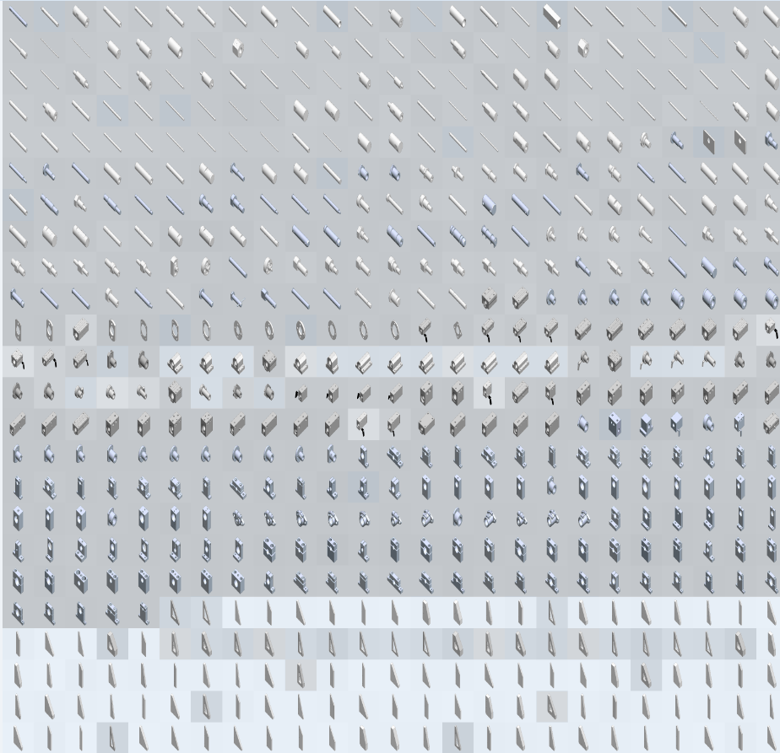
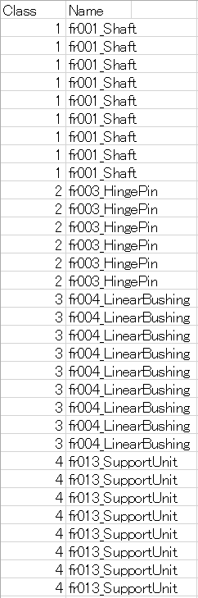
Visualization File
PNG File | .TSV FILE

Slide 5
Data used for visualization:
Step 1: First we train the CAD data using tensorflow, Inception V3 network(or any network).
Step 2: We extract the features form the second last layer(Pooling) from the inception V3 network.
Step 3: We make .tsv file and png file of the train data.
Step 4: We use the extracted features obtained from Step 2 and Step 3 data for embedding visualization in tensorboard.
Data:
Categories Used: 16(Shaft, Linear Bushing, Rib, Locating Pin, Hinge Pin and so on…)
Each category contain maximum 200 images (for testing).
Advantage
How the data are trained.
Clustering of same types of images/ data together.
Clear visualization of trained data.

Slide 6
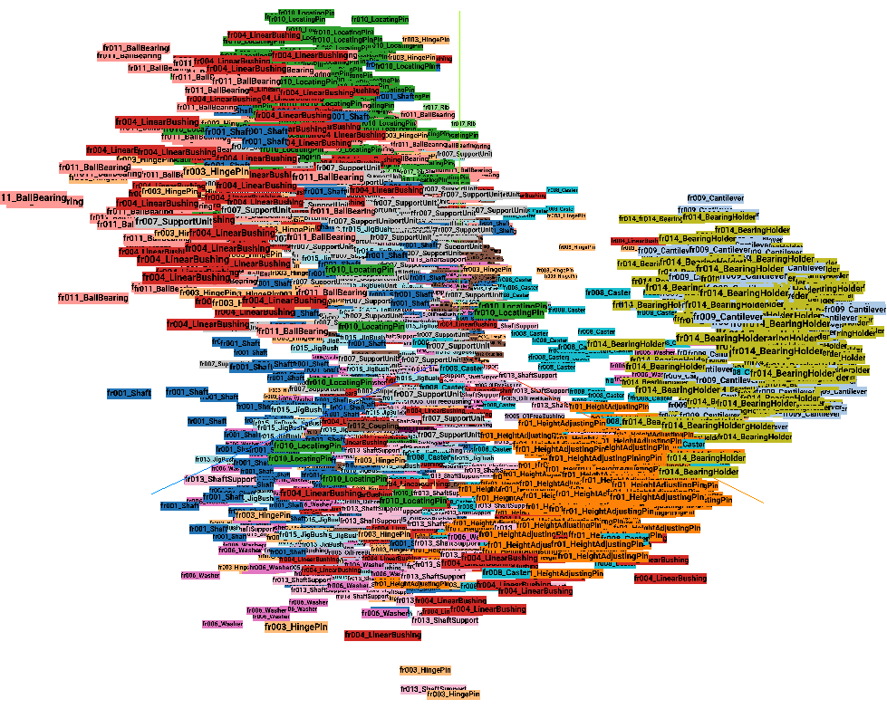
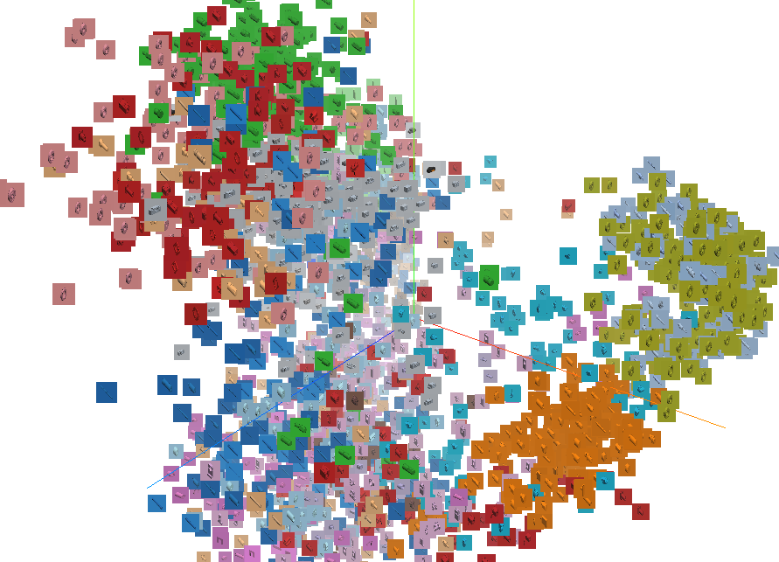
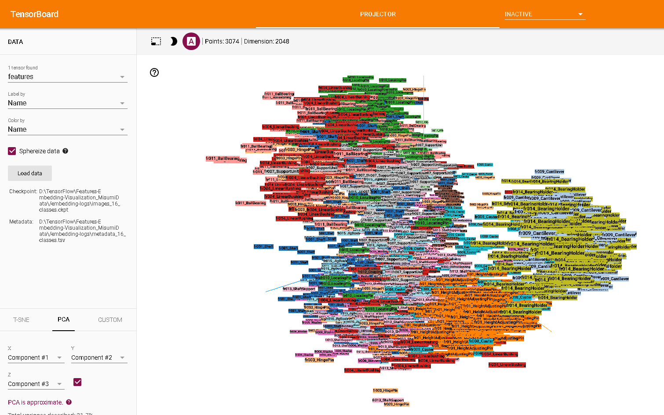
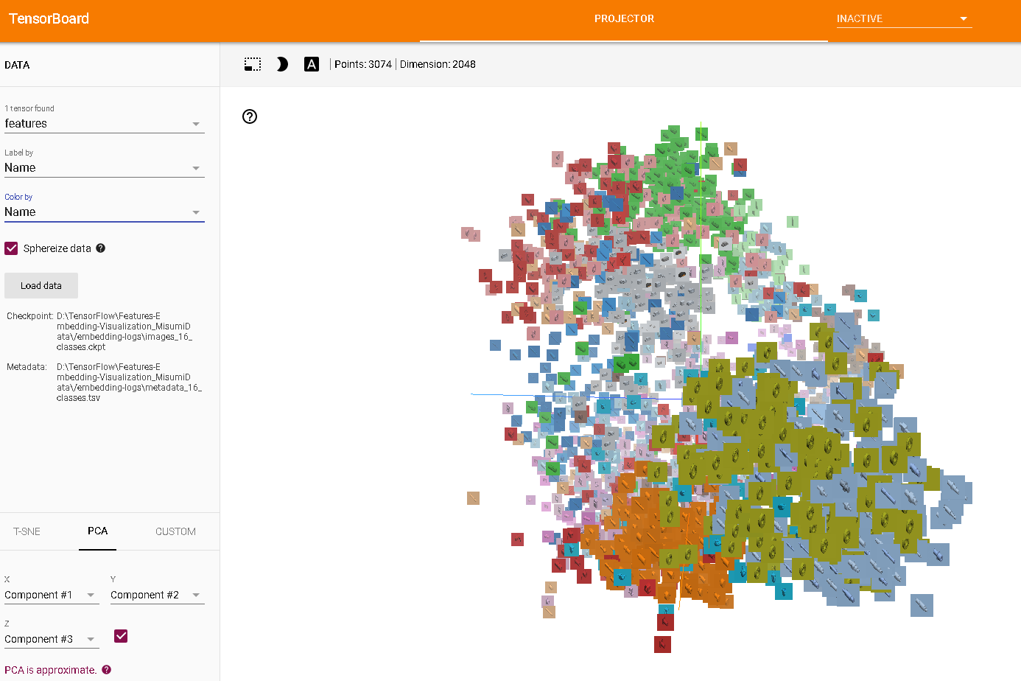
PCA Visualization
PCA(Principal Component Analysis) is a technique to visualize the data
Fig: With respect to Category Name
Fig: With respect to CAD Images

Slide 7
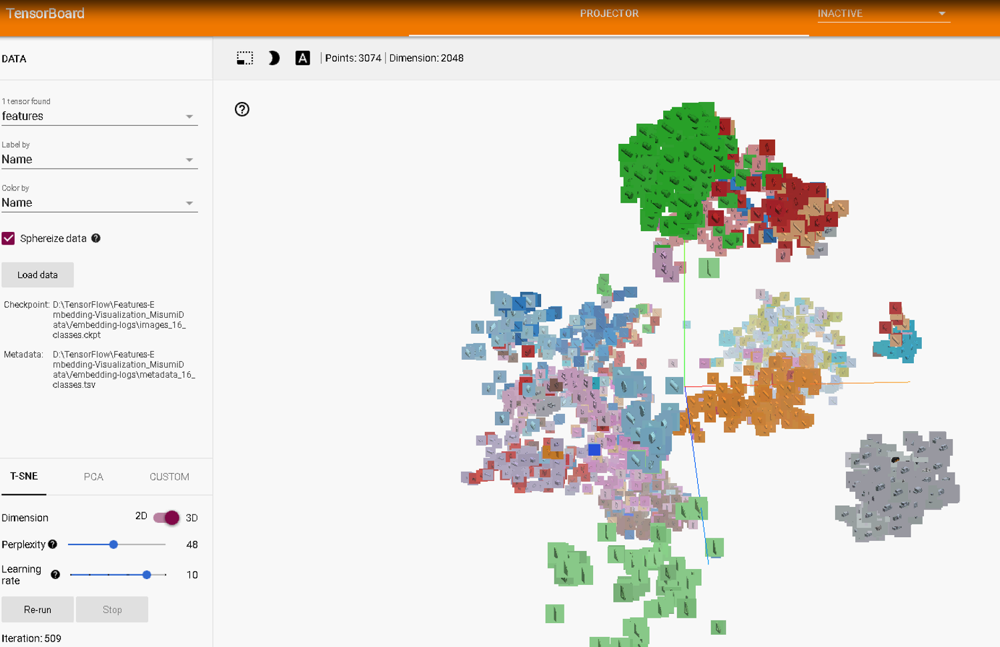
T-SNE Visualization
Another technique to visualize the data
To place the neighbor close to each other
Figure shows clustering of same type of data images.
Fr010_LocatingPin
Fr016_Height Adjusting Pin
Fr007_SupportUnit
Fr017_Rib

Slide 8
Demo
VIDEO

